Slide 1
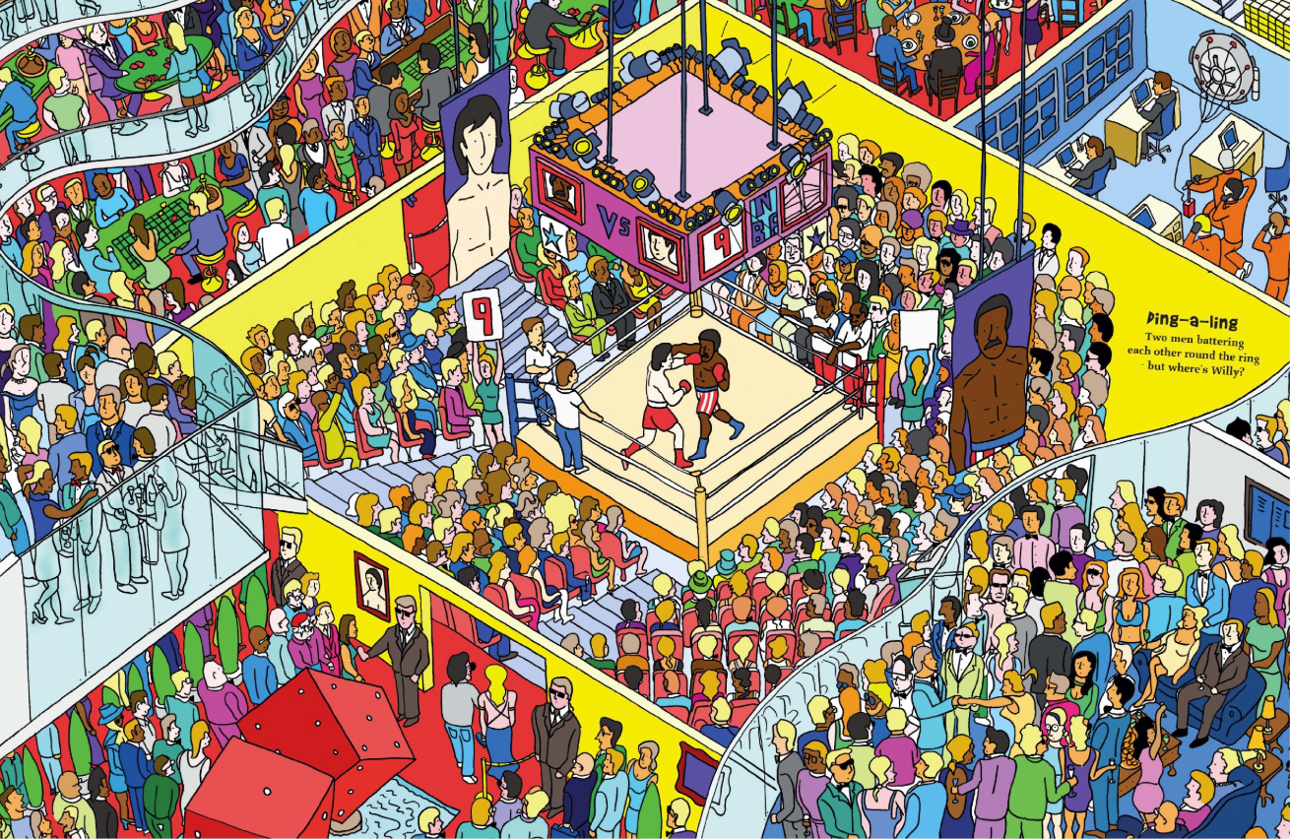
Finding 5 Willy’s
Joaquin Eduardo Villamil Avila

Slide 2

Description
"Finding 5 Wally's" is an interactive game that will challenge your skills to find a unique character under a sea of similar ones. Remember that your Wally will be unique once you name it.
The game uses DataFrames in order to locate que unique character as if you we playing battleship, you will have an immediate response about you result and score in case you made it right.
This game has 5 different levels, where each on them is harder than the previous one, and the score for each level depends on 2 factors, the correct coordinates and the speed of your answer. Good Luck!

Slide 3

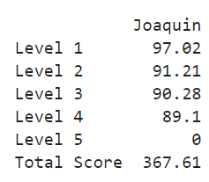
Challenges
Use functions and classes
Usage of dataframes, series, dictionaries and arrays.
Have a score measurement that is evaluated by 2 factors
Keep record of the score and personal characteristics of the users across all the code

Slide 4
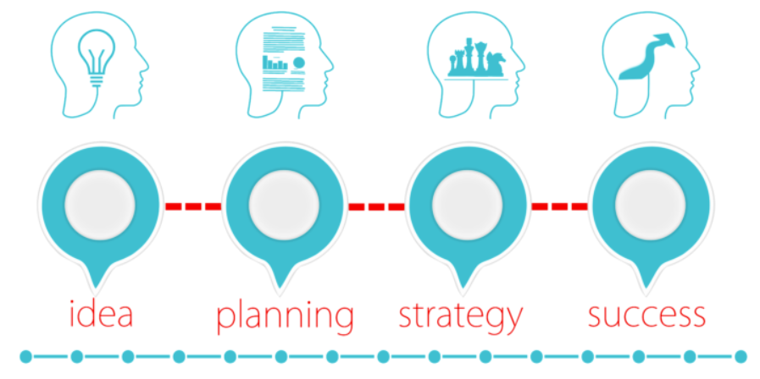
Process
1) Request user personal data
2) Initialize variables from the game
3) Evaluate the start level of the game
4) Initialize the game according the level
5) Game mode where the user gives an input
6) Evaluate the answers from the user
7) Give a score to each level according to the answer given
8) Save the score within the personal data of the user
9) Loop until all the levels are completed
10) Show the score of each level and the Total Score

Slide 5

Learnings
Classes allows you to use different variables across all the code
Time functionality is built in within Python, just import “Time”
Regex can simplify a lot to make validations on inputs
DataFrames make quite easier manage large groups of data and inputs
Functions make the process very simple to understand and easy to reuse your same code
Don’t do it 1 day before, you will sleep less than 1 hour.

Slide 6
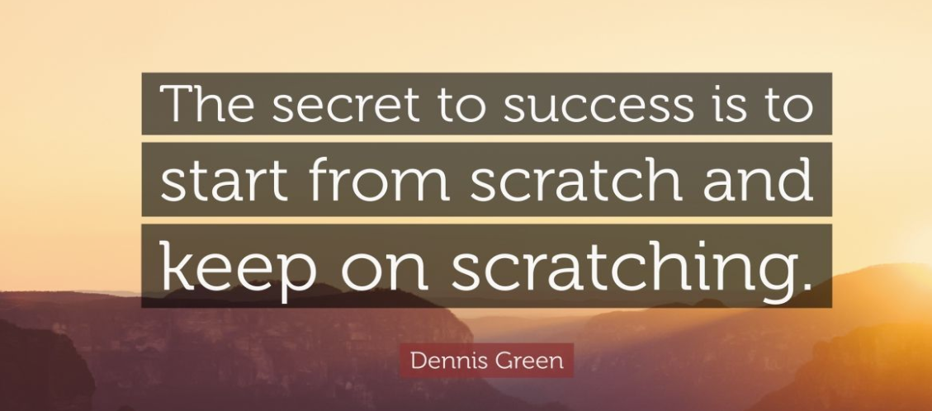
If I were to start from scratch…
I’ll see an option to make this project as something I can use latter on
I’ll start is 2 weeks ago
I’ll select a Tic Tac Toe or a Hangman xD

Slide 7

Improvements
More Levels
Different characters on each level
Leaderboard to keep track of the Top 10 highest scores with the personal info of the users, saving the info on a txt
Make a versus mode to challenge your friend

Slide 8
Highlights
Use of dataframes, series and dictionaries
7 different funtions to make this happen
Time functionalities to measure efficiency of the answers given
Continues feedback to the user according the given answer
Stoppage time between levels to give the user the needed time to adjust himself for the next level and also for a better tracking of the time that the user takes for every level

Slide 9
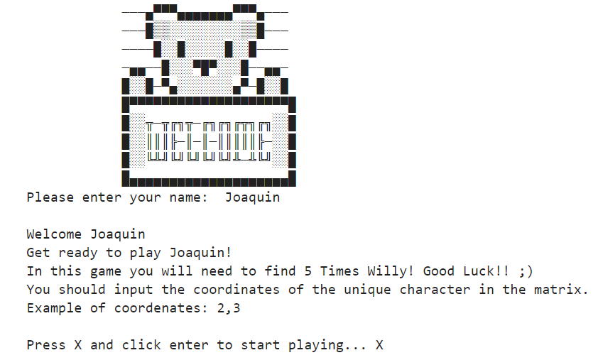
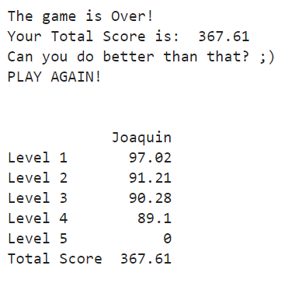
Demo
START
Game Over

